Slide 1
Introduction
Nowadays requirement of loan is increasing day by day . People take loans for different purposes.
So banks is the most reached place for loan , and banks have their own methods or formula to predict whether the person is eligible for loan or not .
Loan eligibility depends on various factors like – Gender, marriage, graduate, credit history, number of dependents, education and income and many more.
So in this project I am going to make a model which will tell whether the person is eligible for loan or not .

Slide 2
Dataset
Gender
Loan_ID
Married
Dependents
Education
Self-employed
Applicant income
Coapplicant income
Loan amount
Loan amount term
Credit history
Property area
Loan Status

Slide 3
Support Vector Machine
We would be using SVM model for loan prediction as it is most supervised learning algorithm which is also used for classification.
There are two type of SVM – linear and non-linear . I would be using linear SVM as Linear SVM is used for linearly separable data, which means if a dataset can be classified into two classes by using a single straight line.

Slide 4
Approach
As we need to predict whether the person will be eligible for loan or not so we need a model which can predict.
We can do it with logistic regression also but using SVM is good as it is a supervised learning model .
So we start for joining the two datasets i.e., train and test using concat

Slide 5
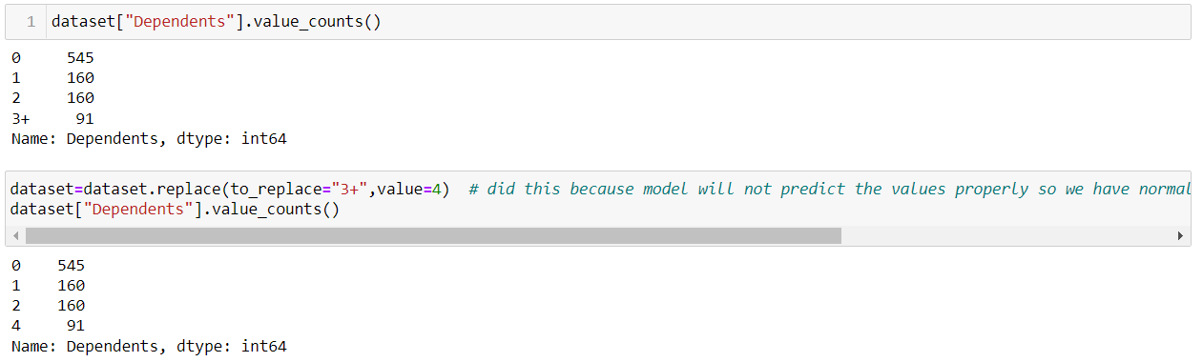
We will remove all the extra dataset which we think that don’t effect our model in predicting
As loan_ID don’t affect loan eligibility
Next I have find the values in Dependents dataset and came to know that their values are 0,1,2,3+. 3+ mean more than 3 so here our model will find difficulty in predicting the correct value. So we will change it to 4 where even we find 3+.

Slide 6
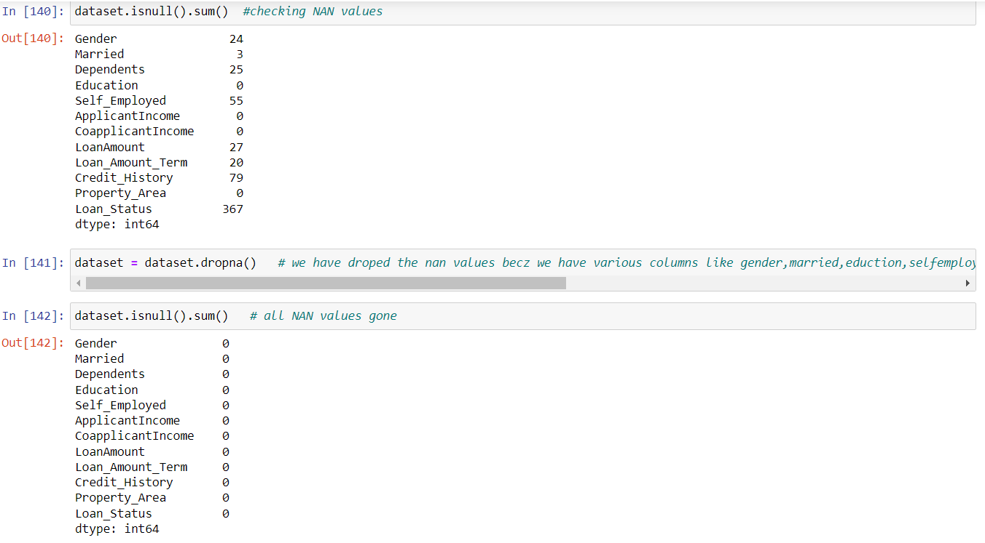
Further we have to handle nan values in our model . So we need to check whether our model have nan values and if we have nan values then we have to handle them.

Slide 7
Dropna is not always a good practice to handle nan values but here we have nan values in dataset that contain text format so we cannot find mean, mode, median . If we would have nan values in dataset that contain only numbers only their we could have filled the nan values with mean, mode, median.
Now we need to change the values of categorical columns to numerical format as our model is only trained to take numerical values.
We have changed categorical columns like-Married, Gender, Self-Employed, Education, Property_Area, Loan_status into numerical values of 0 and 1 and took 0.5 for semiurban.

Slide 8
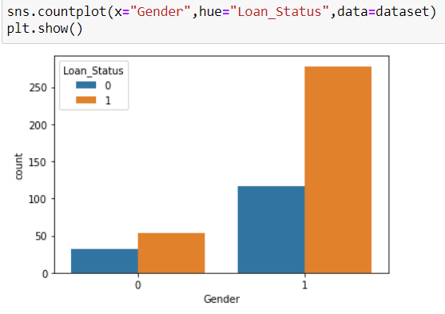
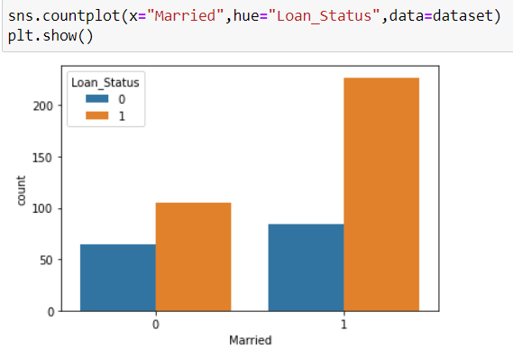
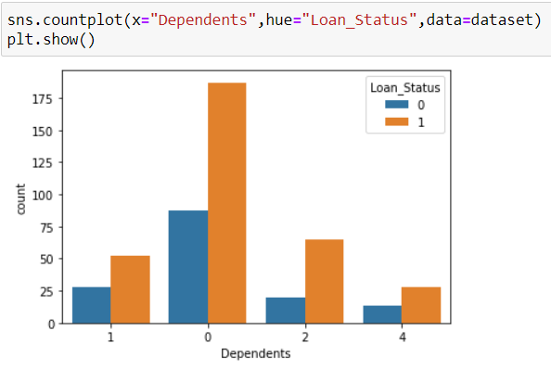
Now we will make a graph which will show relationship between –
Gender and loan_ID
Married and loan_ID
Dependents and loan_ID.

Slide 9
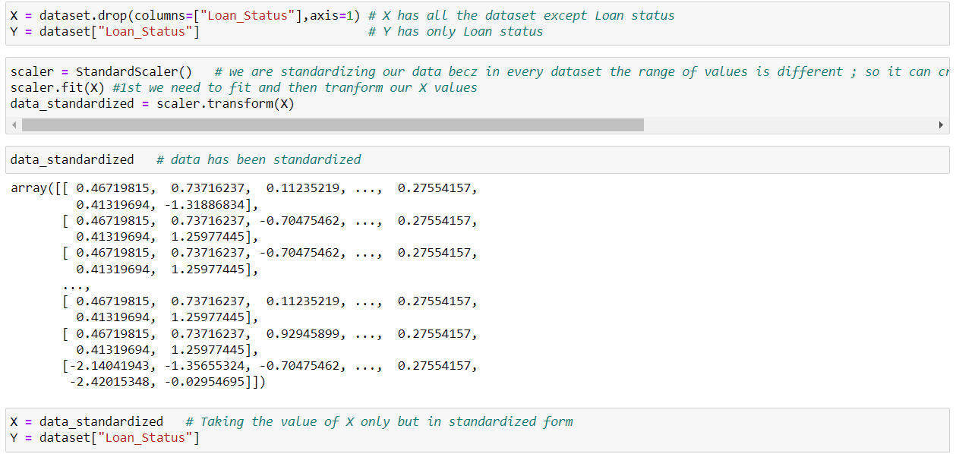
As all the dataset have their own values that mean their range differs so we need to standardize the datasets so that all the values come in a particular range.

Slide 10
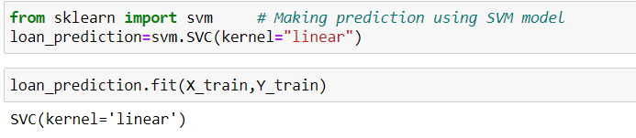
Now we will be training the model with 70% of dataset and 30% of dataset for testing.
It’s a good practice to 70% for training and 30% for testing or 80% for training and 20% for testing.
Now we have train the model and now we need to do the predictions using SVM linear model.

Slide 11
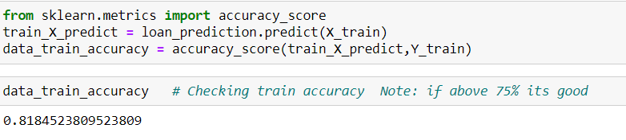
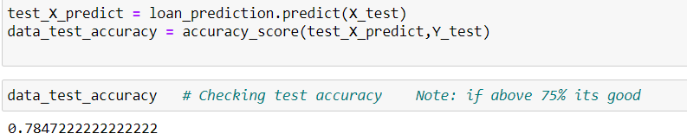
Accuracy
Train data accuracy
Test data accuracy

Slide 12
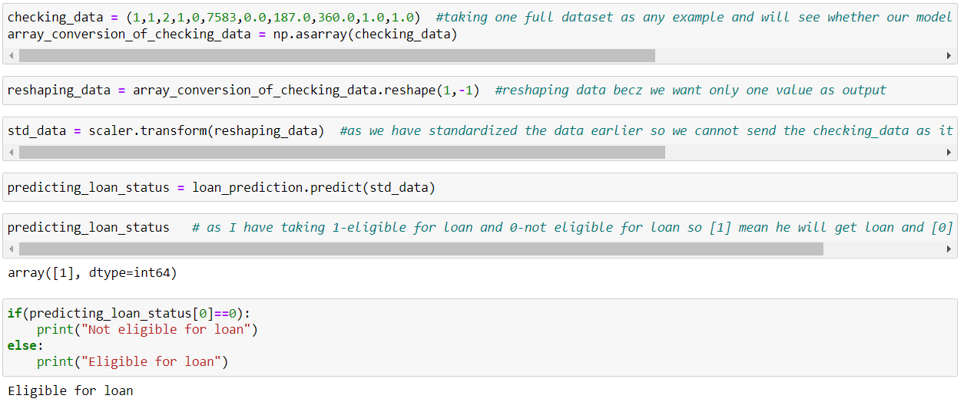
Conclusion
So I will take some values in checking_data to test by myself whether my model is predicting the value correctly.

Slide 13
We cannot directly pass the values for prediction as we have standardized the values of dataset earlier so we need to standardized the values in checking_data.
Further we need to reshape the values because we are predicting only one values.
If the value of prediction_loan_status is [0] that mean the person is not eligible for loan and if the value of prediction_loan_status is [1] that mean the person is eligible for loan.
So I had made an if condition that if result is 0 it will print Not eligible for loan and if result is 1 it will print Eligible for loan.

Slide 14
Future Work
We can make different predictions not only in the field of loan approval but in many fields like – whether the person is having disease or not, whether the person is eligible for job or not .
Making these predictions it become easier to tell whether the person is eligible or not.
From this we can make predictions and on that predictions we can do other work. Taking the example if our model has predicted that he is eligible for loan then further works mean – what will be the amount of loan.
So making these predictions makes other work simpler.

Slide 15
Reference
https://www.javatpoint.com/machine-learning-support-vector-machine-algorithm
https://scikit-learn.org/stable/modules/svm.html
https://www.geeksforgeeks.org/support-vector-machine-algorithm/
https://towardsdatascience.com/logistic-regression-detailed-overview-46c4da4303bc

Slide 16
Thank You

